Slide 1

WIPRO NGA Program – DWS
Capstone Project Presentation – 4th September 2025
Title: Repackaging an Application with Separate Registry Keys.
Presented by -
34851-Krishna Verma
Email: kv979539g@gmail.com
www.rpsconsulting.in

Slide 2


APPLICATION
REPACKAGING
2
2025 - RPS Consulting all rights reserved

Slide 3
INTRODUCTION
With this presentation, we will be seeing that how could we use Advanced Installer to customize and Re-Pack an existing application to configure manually defined registry keys automatically during installation.
3
2025 - RPS Consulting all rights reserved

Slide 4
WHAT IS APPLICATION
REPACKAGING
The process of converting an existing software installer (an EXE) into a new, custom installer format (an MSI) that meets specific corporate deployment standards.
4
2025 - RPS Consulting all rights reserved

Slide 5
BENEFITS
  Standardization: Deploy applications on a large number of devices within an organization without the manual human intervention.
  Customization: Add or remove features needed according to the organization.
  Troubleshooting & Compatibility: Repackaging helps to troubleshoot and fix most common compatability issues with an application.
5
2025 - RPS Consulting all rights reserved

Slide 6
Objective: Repackaging an Application with Separate Registry Keys.
Prerequisites:
  Advanced Installer & Reinstaller Package.
  The Application which is to be repackaged- CloudFlare WARP
  Clean Virtual Machine to perform the Activity.
  Access to Windows Registry Editor
6
2025 - RPS Consulting all rights reserved

Slide 7
Minimum System Requirements
CPU: A Core 2 class processor or equivalent is the baseline.
RAM: You need at least 1 GB of RAM to run the application.
Storage: A minimum of 2 GB of free hard drive space is required for installation and operation.
Display: The minimum supported screen resolution is 1366x768.
Operating System: Advanced Installer requires Windows 10 or newer to run.
7
2025 - RPS Consulting all rights reserved

Slide 8
Workflow Diagram
Verify all the prerequisites and Start with a clean Virtual Machine
Open the application in Advanced Repackager and take the initial snapshot
Perform the Installation steps, finish it and take the final snapshot.
Review the changes it made and proceed to edit in Advanced Installer.
Run the new installer in New device and ensure that the configured settings are working.
Save the changes and proceed to the Home page to Build the app package.
In the Registry Page, Add or Remove the registries entered by the app installation.
Finish
8
2025 - RPS Consulting all rights reserved

Slide 9
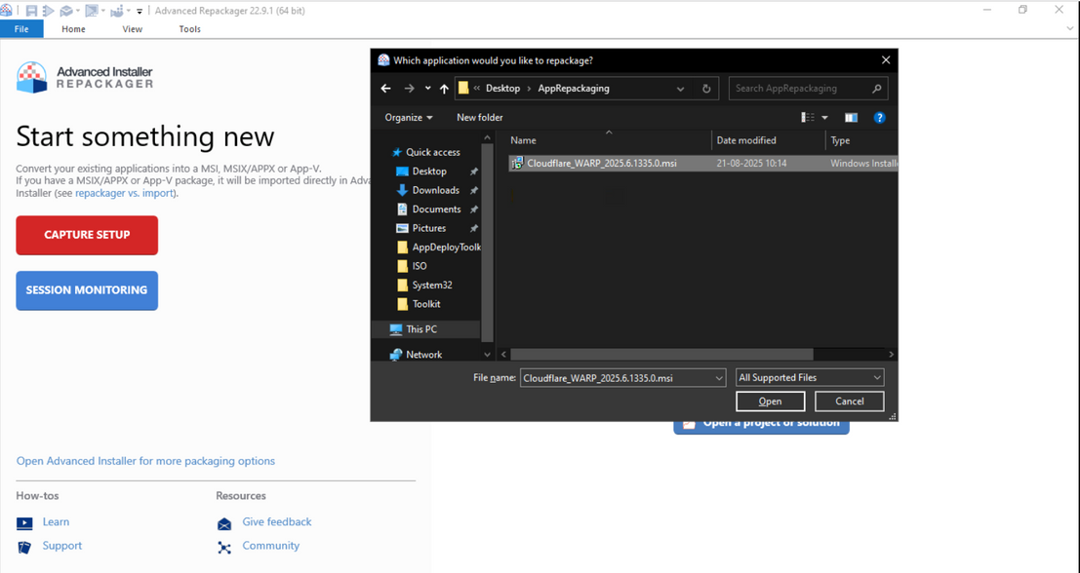
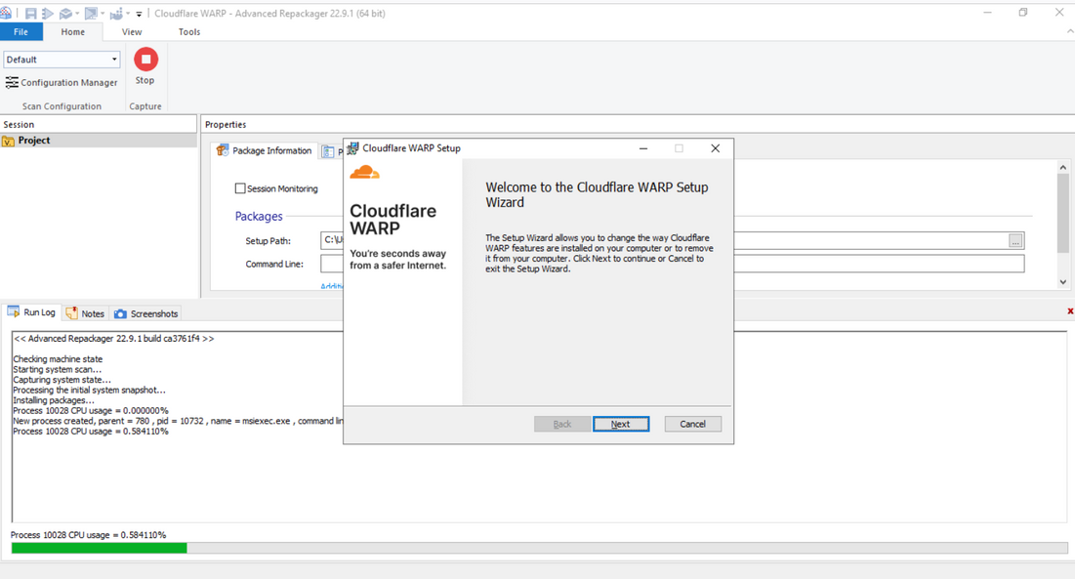
STEPS:
  Click
2. Double Click
  Open the Advanced Repackager import your application by clicking on Capture Setup.
2. After importing the application, start installation it will capture all the changes occurred in the system while installation.
9
2025 - RPS Consulting all rights reserved

Slide 10
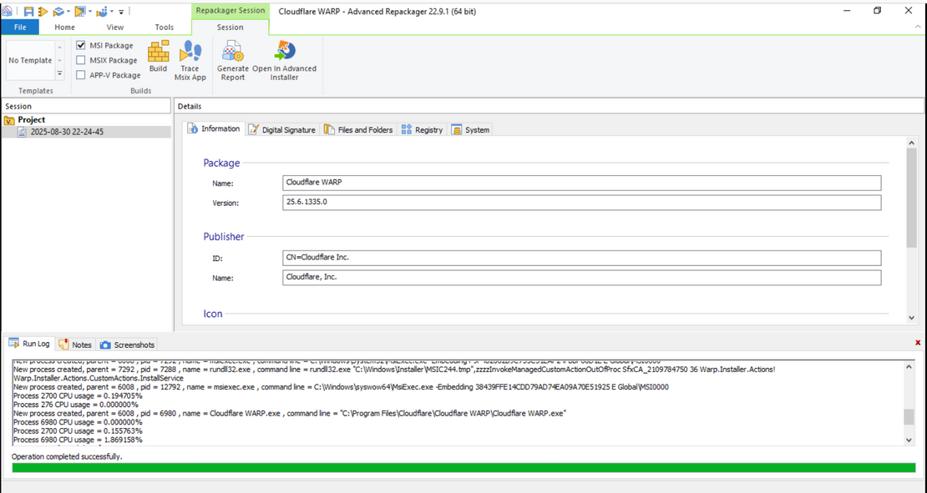
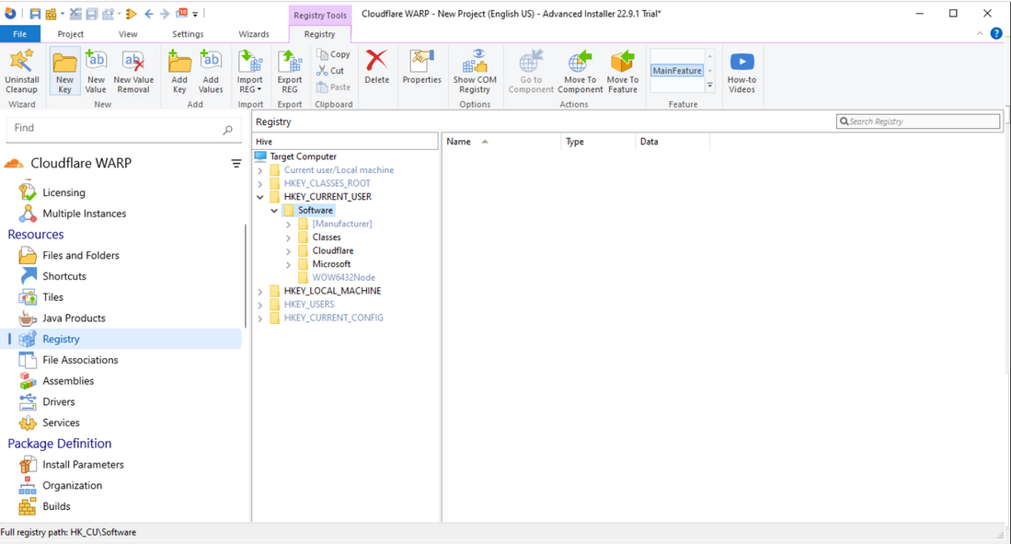
STEPS:
3. Click to add the new key.
2. Expand the Hive
  Click Here
3. After the installation, see the package details and click on Open in Advanced Installer.
4. The unpacked application will be opened in Advanced Installer, scroll down to Registry, expand the HKCU\Software hive and click on New Key.
10
2025 - RPS Consulting all rights reserved

Slide 11
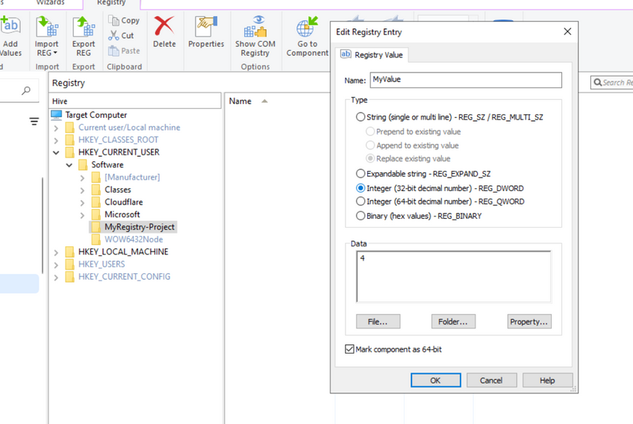
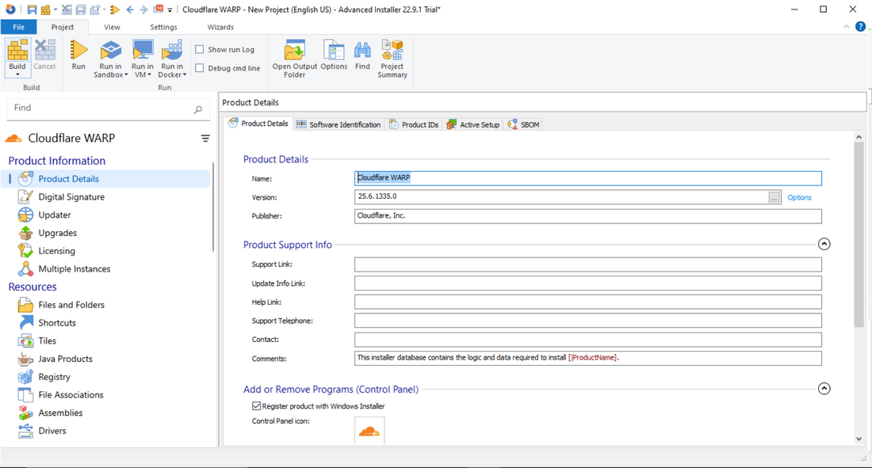
STEPS:
2. Click on build, give path for the
new re-packed package and Done.
2. Set the name for the Value.
  Scroll Back to Product Details
  Right click on the newly created key and select “New Value”
3. Set the data and its type then click OK.
5. Set the name of your Registry, then by right-clicking on the new key, add the new Value. Provide the value name, data and its type and click OK.
6. Scroll back to the topmost part of the list and select Build; give the path and your new package will be saved.
11
2025 - RPS Consulting all rights reserved

Slide 12
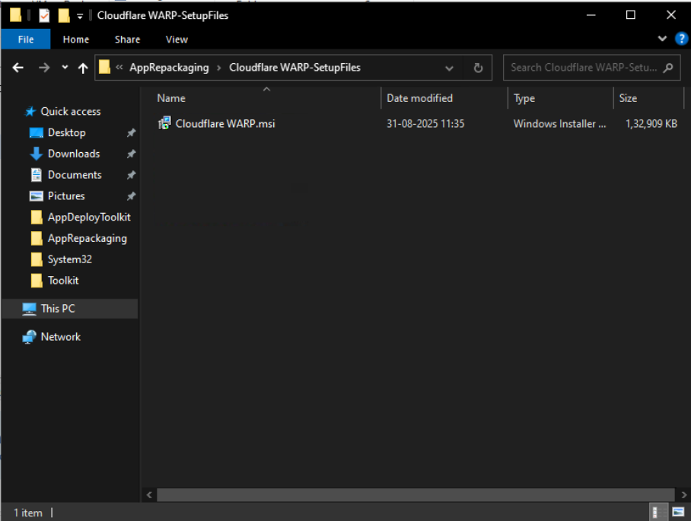
STEPS:
7. We have got the custom installer file, ready to be deployed in new machine which will automatically configure the custom registry keys.
Our newly Re-Packaged application with customized registry configuration is ready.
12
2025 - RPS Consulting all rights reserved

Slide 13
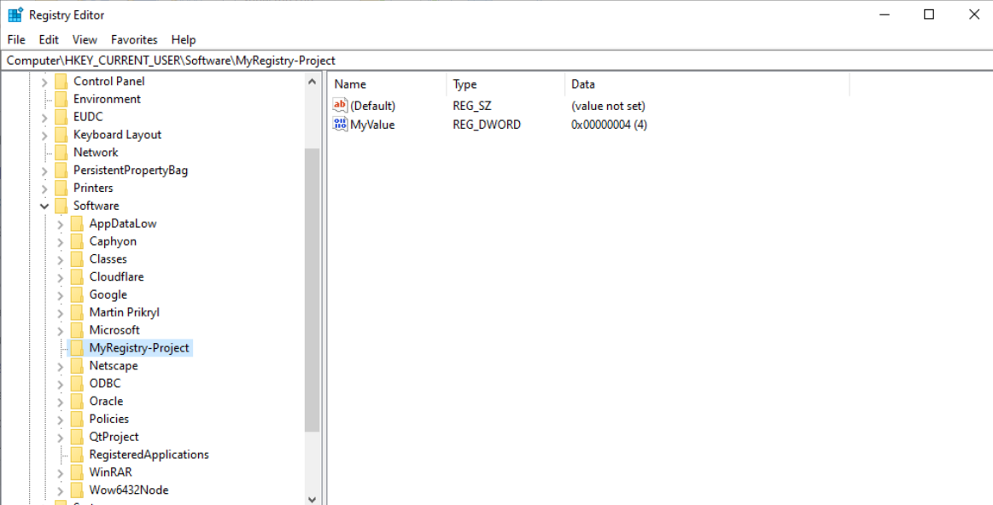
RESULT:
After the installation, the custom made registry key has successfully been created.
13
2025 - RPS Consulting all rights reserved

Slide 14
CONCLUSION
As we saw, we successfully created and installed our customized application which creates predefined registry keys when installed in a system, by using Advanced Repackager & Installer.
14
2025 - RPS Consulting all rights reserved

Slide 15
SOURCES AND REFERENCES
https://www.advancedinstaller.com/
https://www.advancedinstaller.com/user-guide/introduction.html
https://www.advancedinstaller.com/requirements.html
https://developers.cloudflare.com/cloudflare-one/connections/connect-devices/warp/download-warp/
15
2025 - RPS Consulting all rights reserved

Slide 16
THANK you
www.rpsconsulting.in

